Slide 1
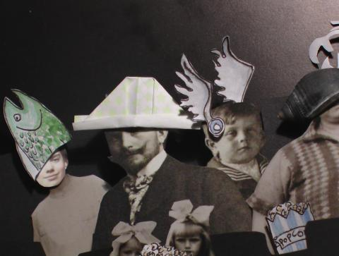



ABC Pool
‘The future of public media’
ABC’s online experimental collaborative media publishing platform where contributors can share content, connect with people and grow ideas across the globe.
Pool must publish content based upon four fundamentals: honesty, fairness, independence, and respect (ABC Editorial Policies)
Launched May 2008
‘Creative Commons licences assisted us to facilitate community media co-creation and sharing.’ – John Jacobs, ABC Pool developer
‘WAT Advert’ by Harriet Macdonald, http://www.pool.org.au/image/harriet_macdonald/wat_advert
AUSTRALIA
part of the Creative Commons international initiative
CRICOS No. 00213J
Notes:
So why is the NLA using the CC licences?
There is, of course, the obvious ideological reasoning – PictureAustralia is, after all, part of the national collection, and the more freely available the photographs are, the better.
It also provides benefits to the users of PictureAustralia, by creating a pool of photos on the website that can be re-used without needing to get additional permission.
Currently, users have to get permission from the host organisation if they want to reproduce most of the photos in the archive
But most significantly, the NLA also chose to use CC licences because of the benefits content management benefits that provides to them
If anyone has worked in a library, they know that one of the biggest problems with maintaining a collection is making sure that the library has all the permissions it needs to preserve and manipulate the individual works – particularly where the copyright owner may be difficult or impossible to locate
By getting the work under a CC licence, the NLA is able to give people a choice over how their material may be used, whilst still being sure that it has the rights it needs to deal with the work from the outset
This includes making it available on the library’s website, or in a catalogue

Slide 2

GILF
Queensland Spatial Information Council (QISC) Whole-of-Government Information Licensing Project (GILF)
Commissioned in 2005 to review how licensing could be used to enable better access to government assets
So far, study has found that:
  there are significant problems with the Queensland Government’s current approach to information licensing, particularly in relation to the lack of adequate or uniform practices; and
  approximately 85 percent of government material could and indeed should be made available under a CC licence.
Now moving into 3rd stage – pilot implementation for geospatial data
AUSTRALIA
part of the Creative Commons international initiative
CRICOS No. 00213J
Notes:
So why is the NLA using the CC licences?
There is, of course, the obvious ideological reasoning – PictureAustralia is, after all, part of the national collection, and the more freely available the photographs are, the better.
It also provides benefits to the users of PictureAustralia, by creating a pool of photos on the website that can be re-used without needing to get additional permission.
Currently, users have to get permission from the host organisation if they want to reproduce most of the photos in the archive
But most significantly, the NLA also chose to use CC licences because of the benefits content management benefits that provides to them
If anyone has worked in a library, they know that one of the biggest problems with maintaining a collection is making sure that the library has all the permissions it needs to preserve and manipulate the individual works – particularly where the copyright owner may be difficult or impossible to locate
By getting the work under a CC licence, the NLA is able to give people a choice over how their material may be used, whilst still being sure that it has the rights it needs to deal with the work from the outset
This includes making it available on the library’s website, or in a catalogue

Slide 3
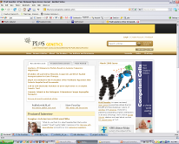

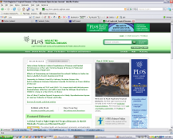
Public Library of Science (PLoS)
Founded in 2000 by biomedical scientists
7 journals across life sciences
Strict peer review and editorial policies
Fully-searchable material freely available under CC Attribution licence - no restrictions on subsequent redistribution or use
Charges academic for publication for cost recovery – large fee, but lowered/waived if necessary
Also undertakes education and lobbies traditional journals to improve access policies
Supports open access as ‘efficient, effective, and equitable’
AUSTRALIA
part of the Creative Commons international initiative
Notes:
Aims to ‘Open the doors to the world's library of scientific knowledge by giving any scientist, physician, patient, or student - anywhere in the world - unlimited access to the latest scientific research.’
A good example of this is the click and flick project
Launched in January this year, Click and Flick is a project of the NLA’s online pictorial gateway, PictureAustralia, in partnership with flickr
I’m sure most of you are familiar with PictureAustralia, but for those who aren’t, it’s an internet portal that allows users to search over 1.1 million images from 45 organisations across Australia and New Zealand simultaneously.
The click and flick initiative was launched in response to complaints that Picture Australia didn’t contain enough contemporary images
It lets individuals contribute their own images to PictureAustralia by uploading them onto dedicated flickr groups.
Most importantly, the National Library encourages people to licence their material as part of the collection under CC licences

Slide 4
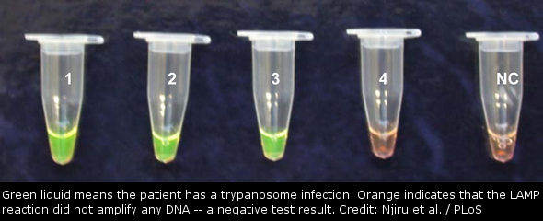
PLoS ‘HAT’ Test
Murdoch University scientists led by Zablon Njiru and Andrew Thompson developed a simple blood test for African Sleeping Sickness (Human African Trypanosomiasis or ‘HAT’) which they published in PLoS Neglected Tropical Diseases under a Creative Commons Attribution licence, making their findings accessible to the world.
‘Scientific works don’t have an isolated meaning; they exist only in reference to the broader scientific community, and the whole reason you publish them is so that other people will read and use them.’ Michael Eisen, Co-Founder, PLoS
AUSTRALIA
part of the Creative Commons international initiative
Notes:
So why is the NLA using the CC licences?
There is, of course, the obvious ideological reasoning – PictureAustralia is, after all, part of the national collection, and the more freely available the photographs are, the better.
It also provides benefits to the users of PictureAustralia, by creating a pool of photos on the website that can be re-used without needing to get additional permission.
Currently, users have to get permission from the host organisation if they want to reproduce most of the photos in the archive
But most significantly, the NLA also chose to use CC licences because of the benefits content management benefits that provides to them
If anyone has worked in a library, they know that one of the biggest problems with maintaining a collection is making sure that the library has all the permissions it needs to preserve and manipulate the individual works – particularly where the copyright owner may be difficult or impossible to locate
By getting the work under a CC licence, the NLA is able to give people a choice over how their material may be used, whilst still being sure that it has the rights it needs to deal with the work from the outset
This includes making it available on the library’s website, or in a catalogue
Quote at http://creativecommons.org/weblog/entry/7038

